Slide 1
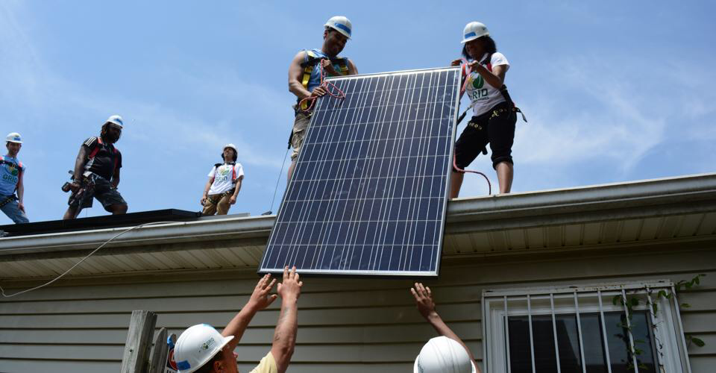
Start of the Illinois Solar Journey
Mark Burger, Solar Consultant, Seven Generations Ahead

Slide 2
Solar Rules of Thumb
What you use AT ONE time
1,000 watts (W) =1 kilowatt (kW), 1,000 kW=1 megawatt (MW)
What you use OVER time (typically an hour)
1,000 watt-hours (W-hr) = 1 kilowatt-hour (kW-hr), 1,000 kW-hr = 1 megawatt-hour (MW-hr)
Average ComEd house uses ~7,500 kW-hr-year (gas heat, hot water)
A 5 kW photovoltaic system (PV) would supply that amount over a year, would need ~500 square feet of roof area to install.
A 1 MW solar installation solar installation (~football field) could supply electricity for ~150 houses or 250 apartments over a year.

Slide 3
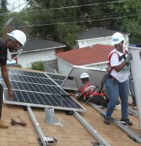
Illinois solar market just getting started
Thru end of 2018 (SEIA.ORG)
0.08% of Illinois electricity generated 2018
3,670 installations
108.47 megawatts (MW) of capacity
25 MW installed in 2018
158,000 megawatt hours generated

Slide 4

Numerous market segments to develop solar electricity, either onsite or offsite
Power Purchase Agreement
Ownership
Community Solar Subscription
Lease
Lease - Purchase
Municipal Aggregation

Slide 5
Got a roof (or other place to install on your property?
On-site solar generation for residential or non-residential building
One system connected to one meter (net meter)
Financing choices
Property holder can own outright, with or without financing.
Property owner can lease system over period of time, with fixed payments, with options to buy
Property owner can buy electricity output from system, called a power purchase agreement agreement (PPA) over period of time, with options to buy.

Slide 6
Don’t have a roof?
Buy solar electricity off site
Community solar subscription starting this year
Residential, and small and medium non-residential
System located in utility service territory
Power Purchase Agreement
Large non-residential
System may be located in or outside state
Municipal aggregation (if offered)

Slide 7
What’s in store for Illinois solar growth (ComEd & Ameren)
Kilowatt – KW Megawatt - MW | RESIDENTIAL 10 kW or less | COMMERCIAL 10 kW to 2 MW | COMMUNITY Up to 2 MW | UTILITY SCALE More than 2 MW
Awarded in 2018 under utility scale procurements |  |  |  | ~10 projects ~1,000 MW
Awarded in 2019 under Adjustable Block Program | 2,503 Projects 17 MW | 1,472 Projects 247 MW | 146 Projects 215 MW
To be awarded later in 2019 under Illinois Solar For All Program | To be determined number of residential, commercial and community projects, ~30 MW of capacity

Slide 8
The long and winding road for Illinois solar
Good News
Caveat
Illinois can increase solar by order of magnitude by 2020-2021
>100 MW to >1,000 MW
<0.1% of electricity to >1.0%
Illinois will need new funding and legislation to go much beyond, such as 10,000 MW and 10% of electricity
Road to 100% renewable electricity by 2050 will need this + more.
Illinois legislation in the works
Path To 100
Clean Energy Jobs Act

Slide 9
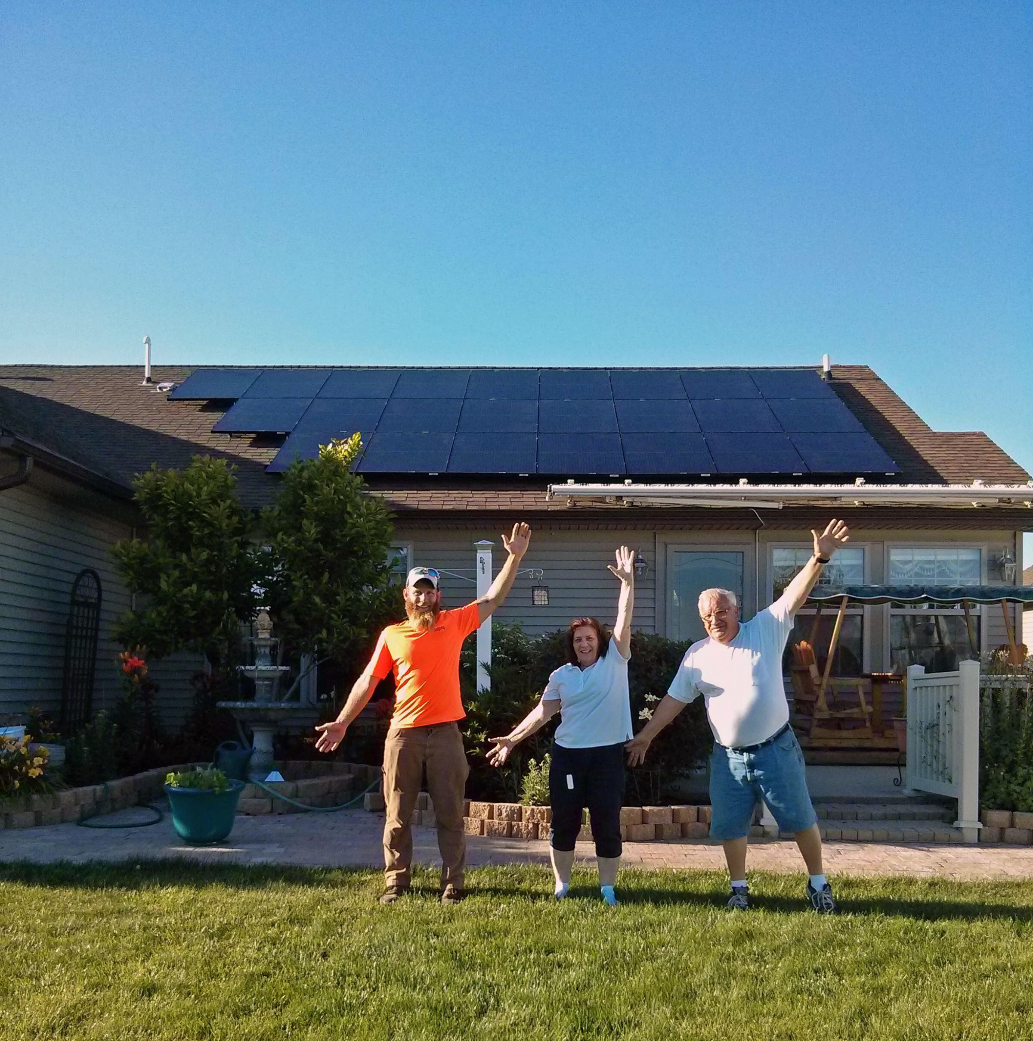
Going forward…
Follow the action at Illinois Power Agency www.illinoisabp.com www.illinoissfa.com
Also follow these organizations
SevenGenerationsAhead.org
ElevateEnergy.org
CitizensUtilityBoard.org
Environmental Law & Policy Center elpc.org

Slide 10
Going forward…
Municipalities
Get your regulatory house in order – solar permitting, inspections, review, etc.
If not a SolSmart.org partner, join >20 Illinois municipalities that are
Solar Actions – online permitting, streamlined processing, eliminate barriers like unnecessary special permitting or hearings.
Municipal Aggregation - consider incorporating solar for residential/small commercial market in existing or as a way to revive inactive programs

Slide 11
Going forward…
Organizations and Individuals
Start planning NOW for solar procurement
Tax credits start phasing out in 2020
Decide on-site or off-site
Plan on a competitive procurement process

Slide 12

THANK YOU!

