Slide 1
Village of Montgomery Solar Permitting
Jerad Chipman, AICP
Senior Planner
Village of Montgomery

Slide 2
Zoning Regulations
The Village passed Solar Regulations in 2011.
Website: https://www.ci.montgomery.il.us/120/Ordinances
The Solar Regulations can be found in Section 4.06 of the Zoning Ordinance
The Regulation are divided into the following categories:
  Definitions
  General Provisions
  Roof Mounted Solar Energy Systems (RM-SES)
  Ground Mounted Solar Energy Systems (GM-SES)
  Utility Scale Solar Energy Systems (US-SES)

Slide 3
General Provisions
Topics outlined in the General Provisions section include:
  Appearance and Signage
  Maintenance and Abandonment
  Utility Notification and Interconnection
    Off-grid systems are prohibited.
  Contractors
  Emergency Disconnect - Required
  Solar Access and Easements

Slide 4
Roof Mounted Systems
A building permit is required.
Manufacturer’s specifications for the panels.
Systems are required to be certified by a licensed structural engineer.
Structural mounting details shall be submitted.
Electrical plans shall be submitted. NEC 2014 Compliant.
A site plan indicating height and location shall be submitted.
Roof vents shall be indicated on the plan. Six (6) inch setback.

Slide 5
Roof Mounted Systems Continued
Height – Allowed to surpass the peak of a roof by one (1) foot.
Roof Coverage
  Pitched roofs: 60% coverage.
  Flat roofs: No maximum coverage, however, shall not impede access, drainage, or obstruct mechanical units.
Setback – Shall not extend beyond the edge of a building.
Hot Water Systems
  Smaller in nature and do not require a structural engineer’s signature and seal.
  Typically installed at a greater pitch than PV panels.

Slide 6
Ground Mounted Systems
Permitted in all zoning districts.
Permitted in the buildable area and the rear yard setback.
Gound Mounted Systems shall be located outside of an easement.
Maximum height in residential districts is twelve (12) feet.
All electrical wiring is required to be installed underground.
The system is required to be rated to withstand winds of one hundred (100) miles per hour or greater.
May need to submit a soils condition report.
Lot Coverage – calculation.

Slide 7
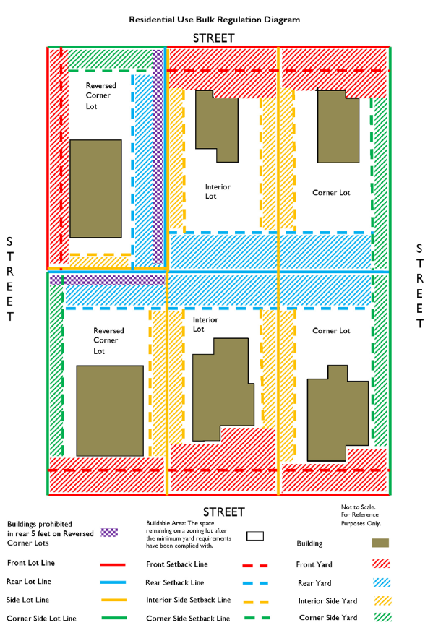
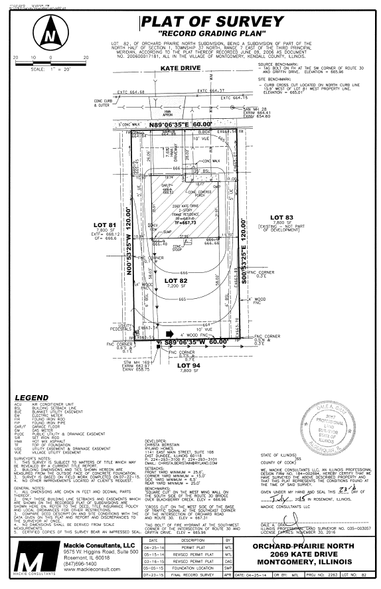
Plat of Survey

Slide 8
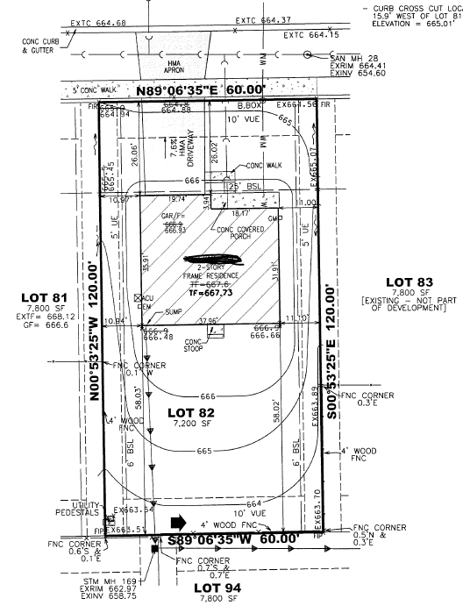
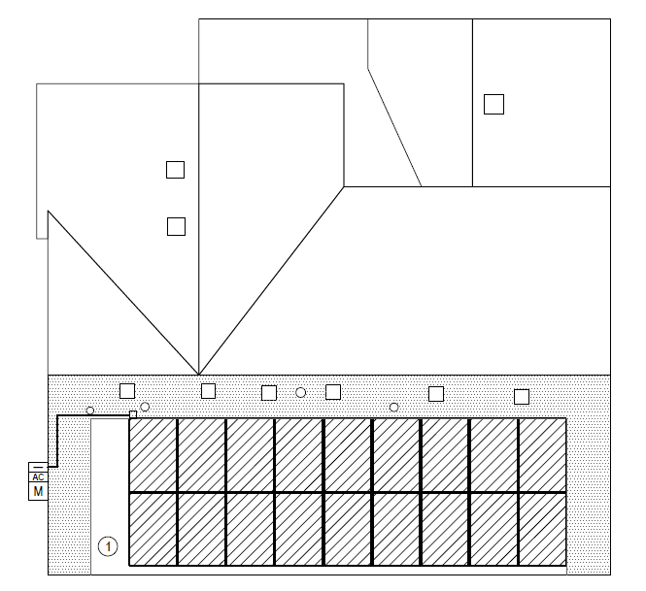
Plat of Survey and Site Plan

Slide 9
Utility Scale Solar Systems
Utility Scale Systems are allowed as a special use in Manufacturing Districts.

Slide 10
Permit Application
The building permit application can be found at the front counter or on the Village’s website.
  https://www.ci.montgomery.il.us/100/Permits
Typically a contractor would apply for the permit.
Contractor’s need to be licensed with the Village.
Application review and approval.
Solar landing page – Village website.

Slide 11
Contractors
Few contractor’s are currently licensed with the Village.
Resources available for researching contractors:
  North American Board of Certified Energy Practitioners (NABCEP)*
    https://www.nabcep.org/nabcep-professionals/
  Illinois Solar Energy Association (ISEA)*
    https://illinoissolar.org/
*The Village of Montgomery does not advocate any single group or contractor, those listed are intended only to assist in the location of information for interested homeowners.

Slide 12
Tax Assessment
Village reached out to area tax assessors.
Little to no impact currently, however, if additional value is added through re-sales of properties this stance could be reevaluated in the future.
One assessor expressed a desire not to penalize residents for installing solar systems.
Recommendation: If you are interested or concerned about property tax affects, the Village recommends reaching out to your tax assessor for more information.

Slide 13
SolSmart Designation
Village’s desire to lead in solar extends to our pursuit of a SolSmart designation.
The Village is a member of the Greenest Region Compact 2.

Slide 14
Panel Questions.

