Slide 1
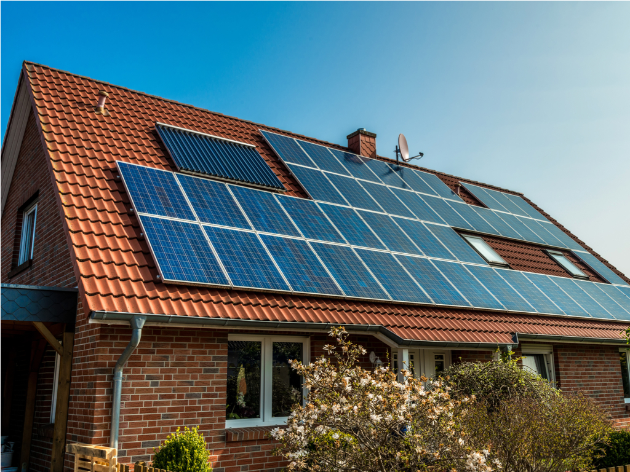
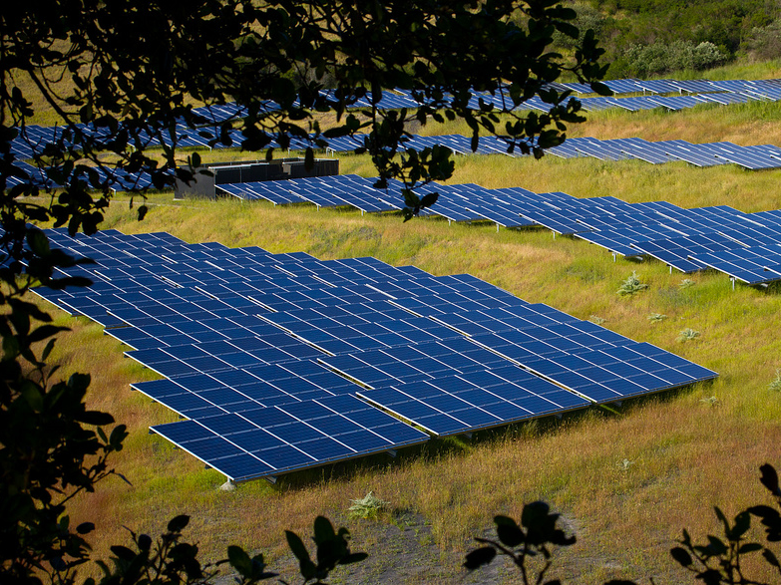

Solar Panels on Your Home & in Your Community
Montgomery Solar Forum
April 30th, 2019
Christina Uzzo
Notes:
Introduce ourselves

Slide 2
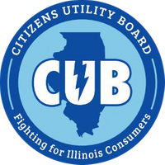
Citizens Utility Board (CUB)
•Represents Illinois utility ratepayers & advocates for cheaper & cleaner energy
•Has saved consumers more than $20 billion by fighting proposed electricity, natural gas, and telephone rate hikes
•Advocated for the Future Energy Jobs Act – which put Illinois at the forefront of renewable energy in the Midwest!
•Operates a consumer hotline to help with utility complaints
•Holds ~500 public education events per year!
www.CitizensUtilityBoard.org

Slide 3
Roadmap
🔼 Solar in Illinois
🔼 Solar Incentives
🔼 Solarize Chicagoland Group Buy

Slide 4
Solar Costs & Incentives

Slide 5
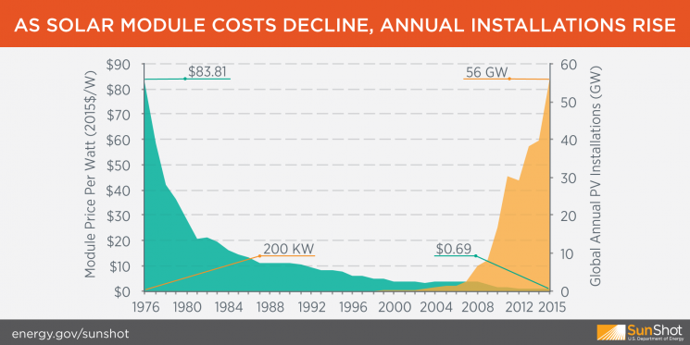

Slide 6
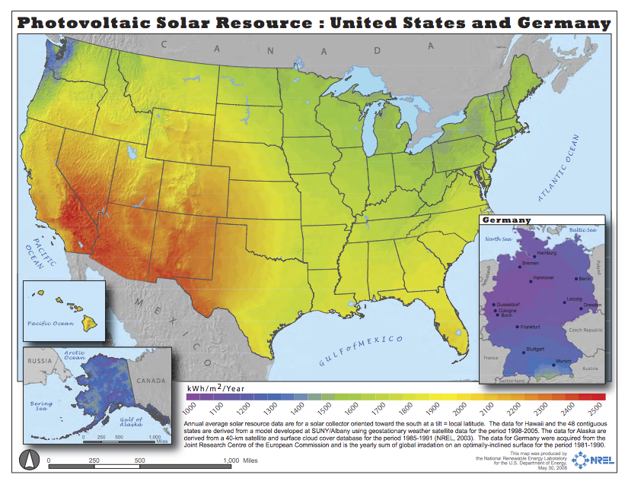
Is there Enough Sunlight?

Slide 7
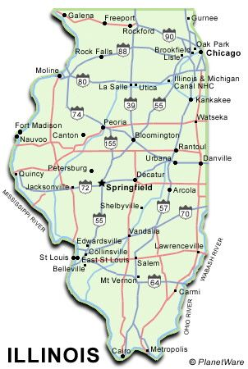
Solar in Illinois
🔼 12,736 homes powered by solar
🔼 327 solar companies in state
🔼 $237.15 million total solar investment
🔼 Ranks 35th in the nation (but up from 42nd in 2017!)
🔼 Ranks 13th for growth projection - 1,399 MW over the next 5 years
Notes:
Stats from ISEA Website. Here is where Illinois fits in.

Slide 8

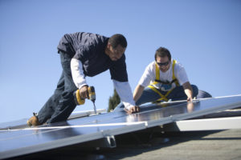
Illinois - The Future Energy Jobs Act
Future Energy Jobs Act (FEJA) passed in December 2016
Set Illinois on a path to achieve 25% renewable generation by 2025
Mandates 4,300 megawatts of new solar and wind by 2030
Commits $750 million to renewable energy job training
Notes:
FEJA was a big deal that alot of people worked on for a long time. It brought alot of needed changes that have made solar energy much more affordable and accessible in our state now.
GIVE AN EQUIVALENCY - CALCULATE HOW MANY WINDMILLS 4,300 MW IS EQUAL TO

Slide 9
Solar Incentives
3 programs together make Illinois a great state for homeowners considering solar!

Slide 10
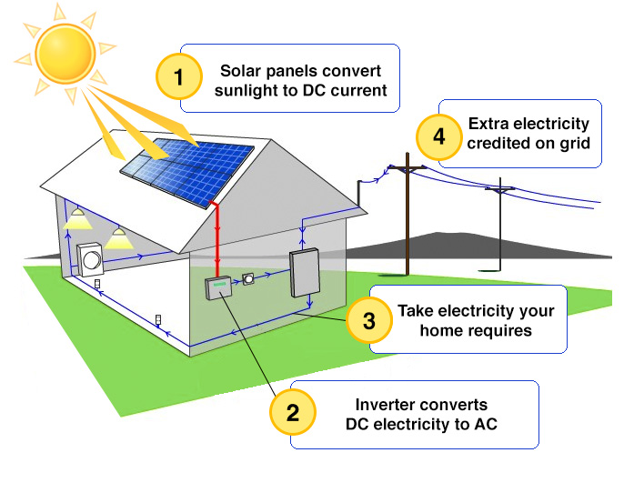
--If you don’t use all the energy generated, it flows back to the grid
--When you use energy directly it is “behind the meter.” This reduces your overall demand from the grid
--When you send energy to the grid it’s considered “in front of the meter” and you get paid by ComEd.

Slide 11
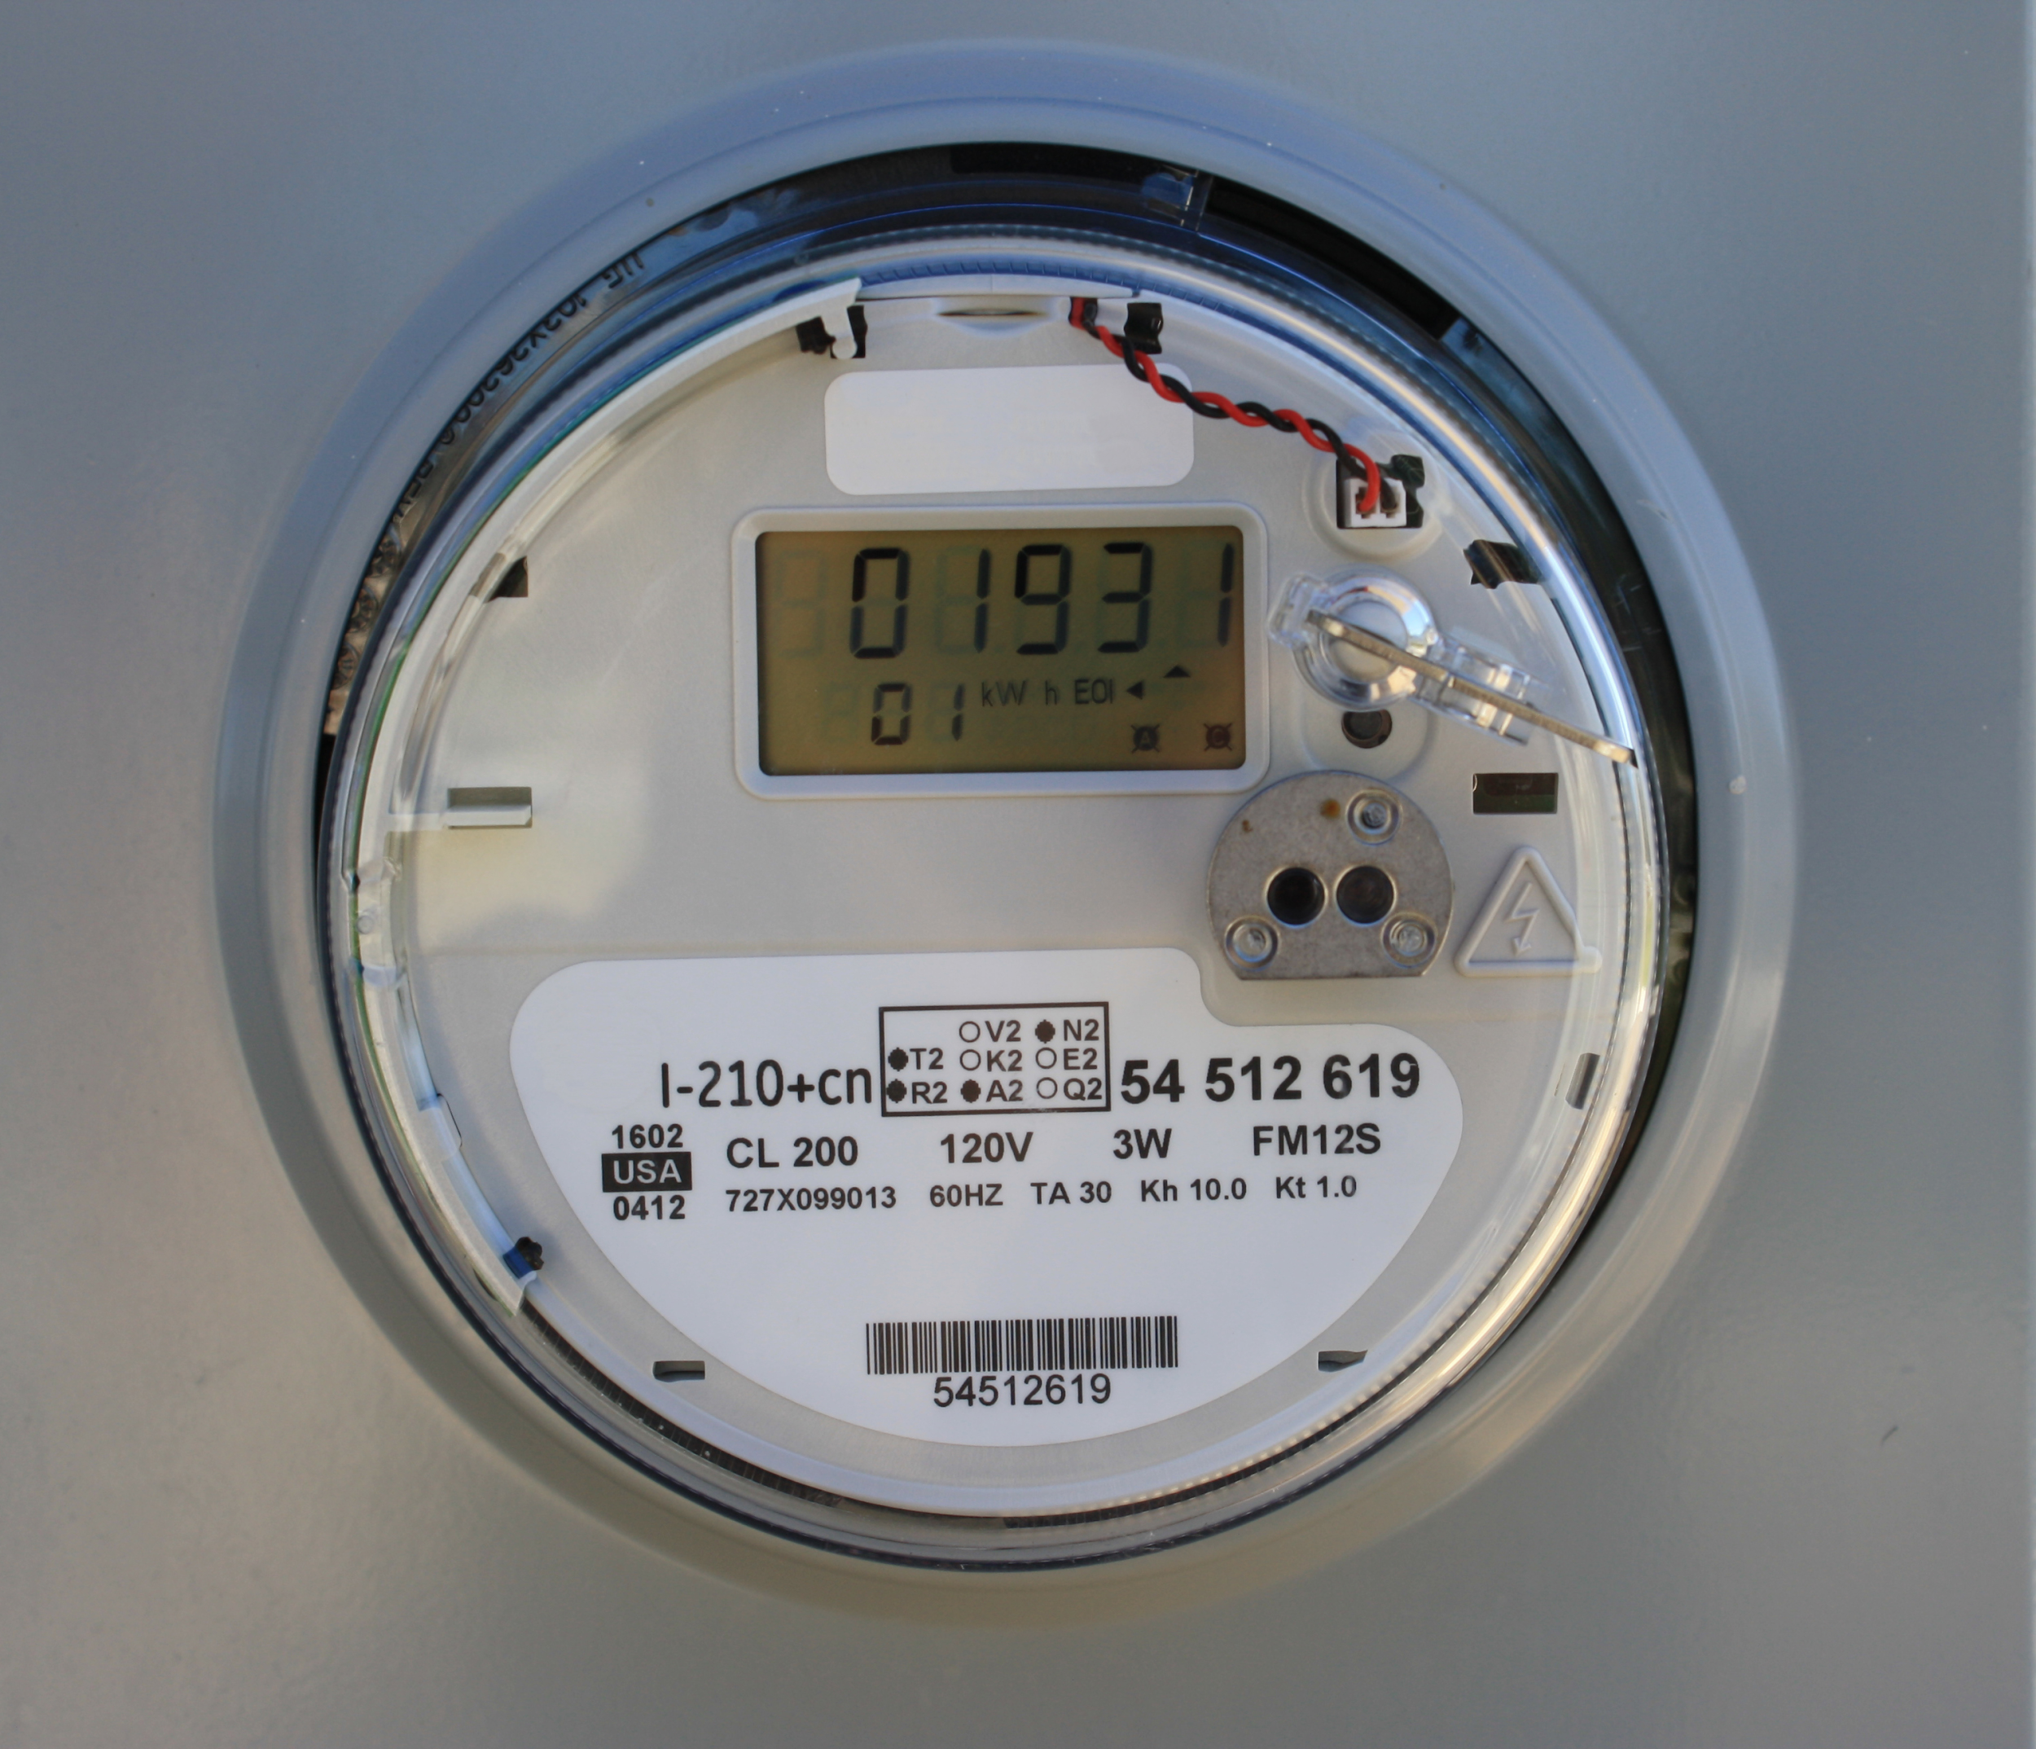
Net Metering
Illinois Net Metering Statute passed in 2008
Required ComEd, Ameren, and MidAmerican to buy back excess solar energy generated by customers.
For systems less than 40 kW, the utility must buy the power at the retail rate for electricity.
NOTE: All residential solar systems are less than 40kW
Notes:
Source: http://www.illinoisattorneygeneral.gov/environment/netmetering.html
Image source: https://www.google.com/url?sa=i&rct=j&q=&esrc=s&source=images&cd=&cad=rja&uact=8&ved=2ahUKEwj42dfN38LdAhVL6IMKHXEXCj4Qjxx6BAgBEAI&url=https%3A%2F%2Fcommons.wikimedia.org%2Fwiki%2FFile%3ASmart_Meter_(10945291434).jpg&psig=AOvVaw25ikaf59P0c_eWBh2vwQhm&ust=1537298030590581

Slide 12
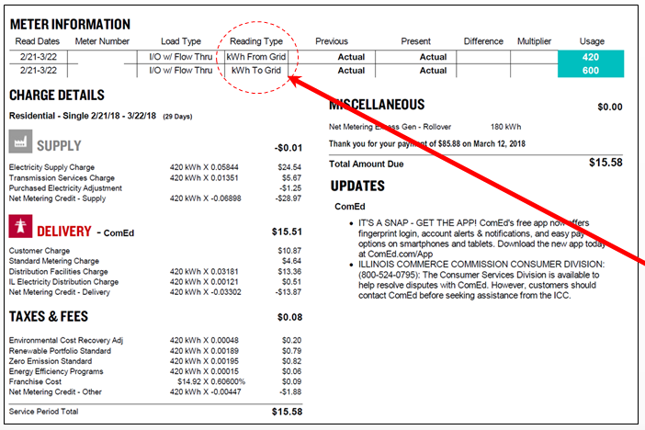
Net Metering on Your Bill
Notes:
From ISEA materials

Slide 13
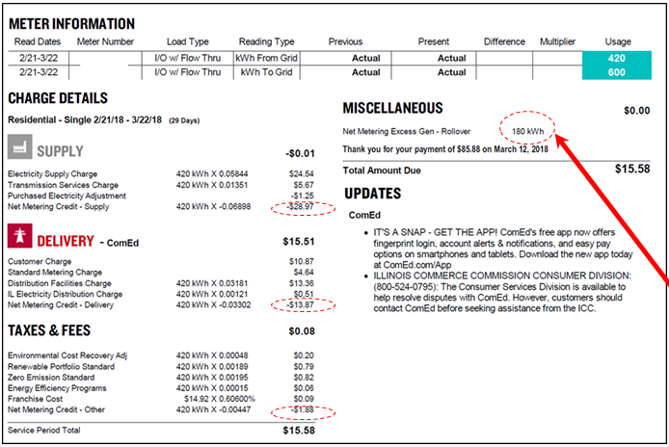
Notes:
From ISEA materials

Slide 14
Federal Programs - The Federal Tax Credit
Deduct 30% of your solar project costs from your fed taxes
Not based on amount of energy produced
If the credit is greater than your income tax liability for that year, the credit rolls over for up to 5 years. (Note: credit is non-refundable)
Tax Credit | Through
30% of your solar project costs | 2019
26% | 2020
21% | 2021
Notes:
Fed tax credit

Slide 15
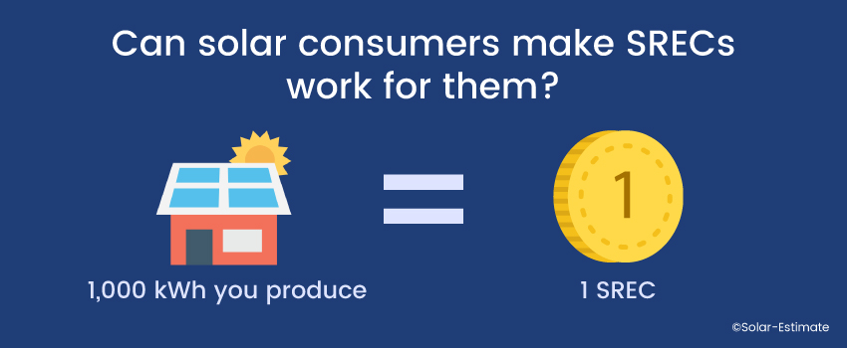
FEJA - Solar Renewable Energy Credits (S-RECs)
To achieve the solar targets, FEJA created Solar Renewable Energy Credits (S-RECs)
RECs can be bought and sold, 1 REC = 1,000 kWh of renewable generation
Illinois will pay you for the energy your solar panels generate
That solar energy will then be counted towards FEJA goals
Notes:
The SREC program was designed to ensure that solar would be built in low income communities, and in urban areas, not just built as large solar farms
https://www.solar-estimate.org/news/2018-02-01-can-solar-consumers-make-SRECs-work-for-them

Slide 16
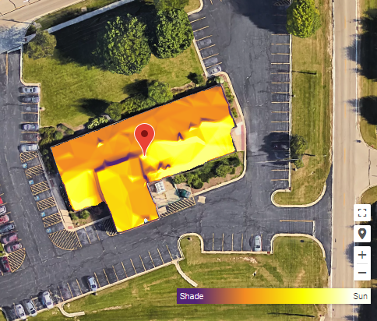
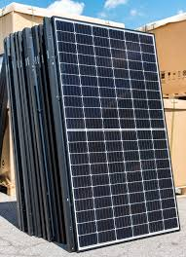

SREC Payments are specific to your system
Specifics of roof & location X number of panels X 15 years = SREC Payment
They estimate how much power your system will generate over the next 15 years.

Slide 17
Calculating Pay-off Time
$23,250 | Average installation cost
(- $8,980) | SREC (assuming 8,775 kwh annual output)
$14,270 | Remaining after SREC
(-$4,281) | 30% Federal Tax Credit
$9,989 | Cost after incentives
Note: Some installers will give you the SREC upfront, but payoff time is dependent on how you get your SREC
Note: Monthly savings estimate is conservative for this example.
$9,989
$880 savings / year
= 11 years 4 month return on investment
Note: Math shown for purchasing not leasing!

Slide 18

Financing Options
🔼 Leasing versus owning -
🔼Leasing is not as economical as it used to be
🔼 Bridge loan - finances upfront cost of solar until you receive the federal and state credit
🔼 Visit www.energysage.com/solar/financing/loan-providers/ to find a low interest, clean energy loan that works for you!
🔼Discuss financing options, including how to receive your SREC, with your installer!
🔼CUB recommends: Always get a quote for purchasing the system and compare, even if you’re considering leasing.
🔼Remember, you won’t receive the SREC or Federal Tax Credit with a lease.

Slide 19
Increasing the value of your home
🔼 Numbers vary, but on average:
🔼 1 kilowatt of solar = $5,911 in increased resale value
🔼 Installing 5kW of solar can increase the value of a home by up to $29,000!!
🔼 Source: https://www.costofsolar.com/is-my-home-worth-more-with-solar-energy/
Notes:
https://www.costofsolar.com/is-my-home-worth-more-with-solar-energy/

Slide 20


Solarize Chicagoland
A Solar Consumer Education Campaign!
50 + presentations throughout Chicagoland
Looking into securing accompanying discounts for residents of Kane, Cook, DuPage, and Cook Counties!
SolarizeChicagoland.com for more information

Slide 21
Thank you!
Feel free to contact CUB with any questions:
Christina Uzzo
Environmental Outreach Coordinator
cuzzo@CitizensUtilityBoard.org
(312) 263-4282, x. 134

